Slide 1

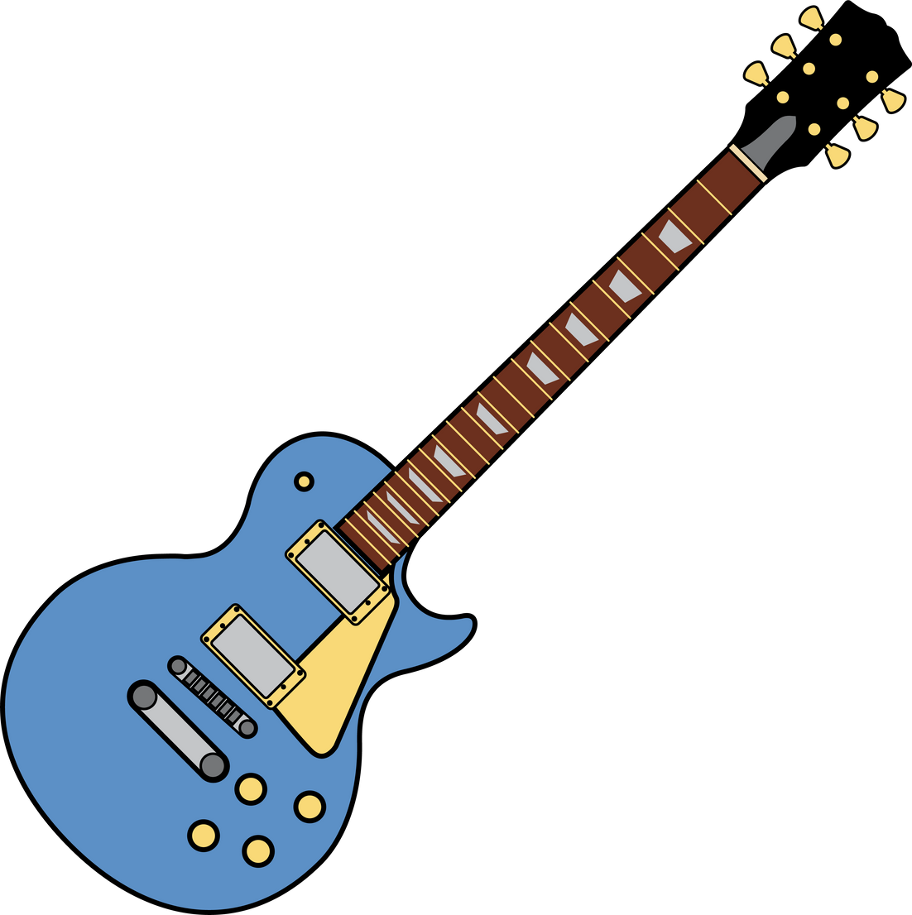
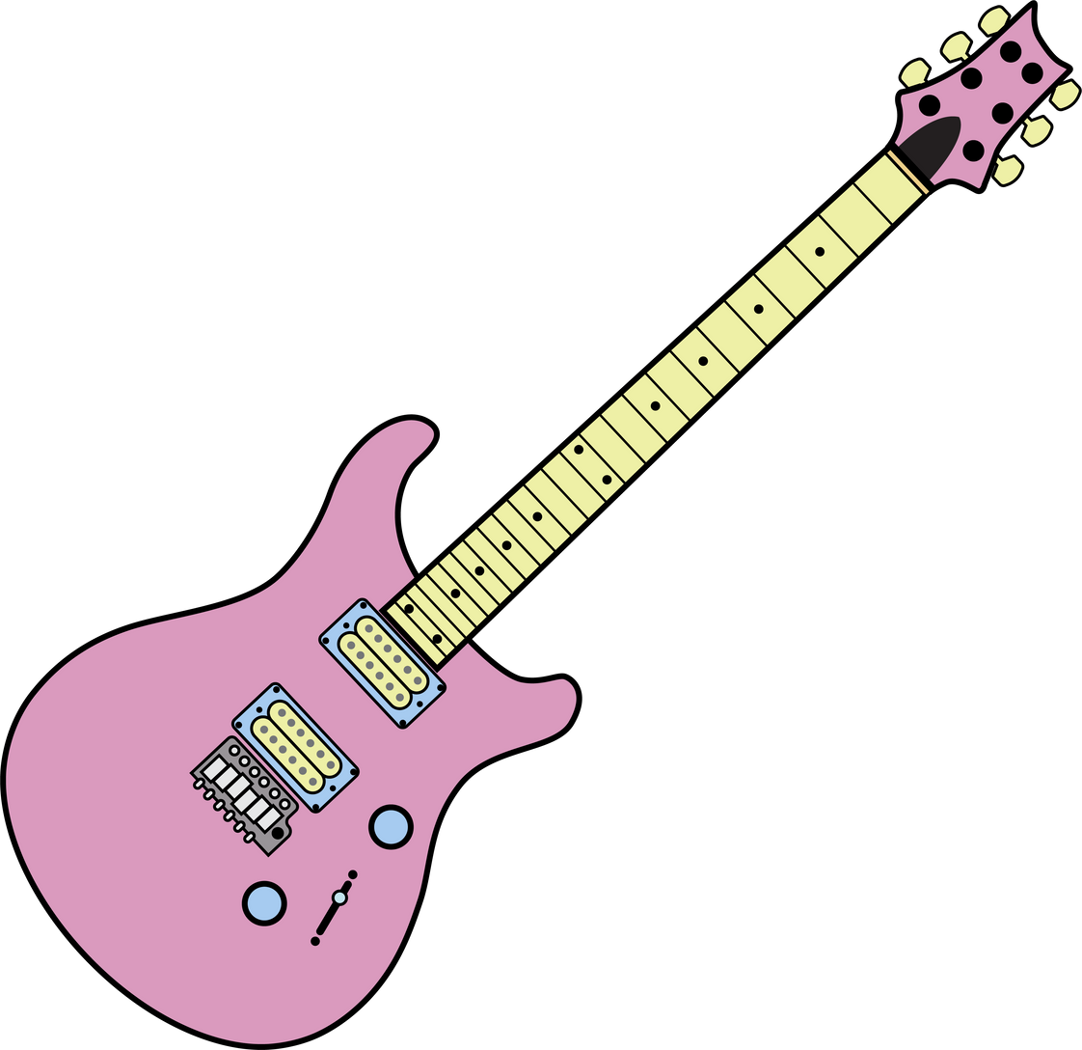
Electric Guitar Body Detection: A Machine Vision Approach
Exploring Template Matching and Haar Classifiers
Team Composition:
...
...
...
...

Slide 2
Research Goals
Develop a tool to detect and classify guitar body types in images
Improve automation in image-based content tagging
Make progress towards the analysis of the impact of guitar body types physical characteristics in audiovisual advertising

Slide 3
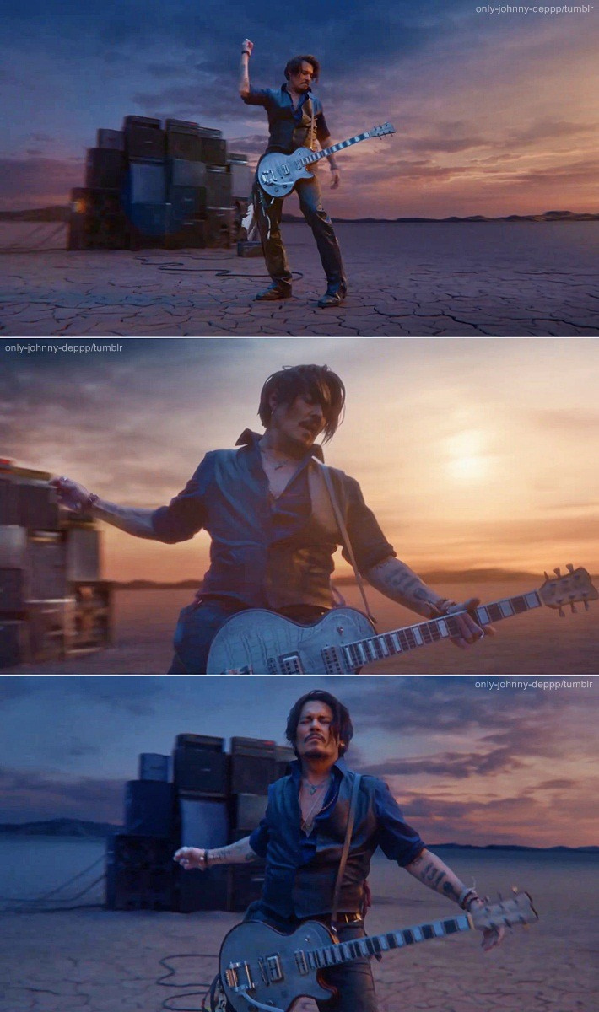
Motivation - Why Focus on Electric Guitar Bodies?
The cultural and symbolic status of electric guitars
Strong visual impact in marketing and advertising
Lack of research on physical guitar characteristics

Slide 4
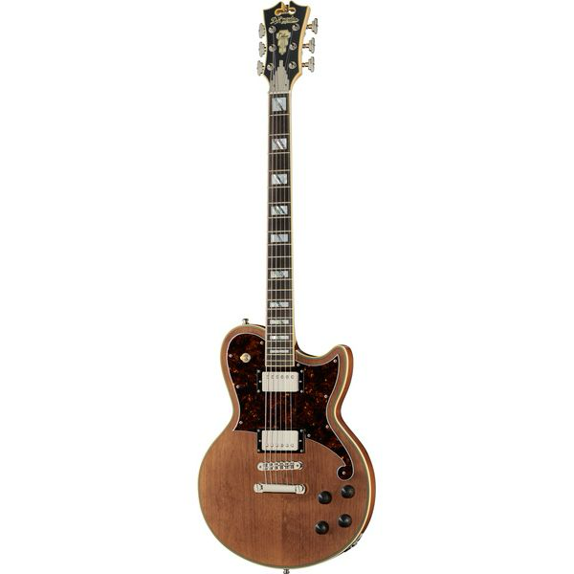
Data Collection
Web Crawler Development
Thomann.de posed as a promising source of “clean” guitar images to utilize in all our approaches.
Uniform Lighting & Consistent Illumination: The lighting across the image is even, without harsh shadows or bright spots.
Minimal Background Clutter & Plain Background: The background is simple and consist of a single (in each image) color with strict “bands” in each case.
Developed an agent using python’s Playwright library to download guitar photos, classifier per their body type.

Slide 5

Data Validation and Cleaning
Data Cleanup
Some images retrieved by the crawler were rotated or showed the back sides of guitars, so we performed a manual cleanup to replace such cases with “clean” instances.

Slide 6
Approach 1 - Naive Template Matching
Problem Statement
We are looking at clean cases of image photos and want to be able to automatically detect the depicted guitar body types.
End Goal
Creation of generalized one-piece full-body binary mask templates for each guitar type.
Guiding principles:
Broad Applicability
Automation
Numerical expression of distinguishing features going beyond what our experience suggests

Slide 7


Approach 1 - Challenges & Assumptions
Fundamental Assumption:
There is a “definitive shape” for each guitar type.
We sticked to the task of recognizing the hallmark models of the industry giants, Fender and Gibson.
Stratocaster - “T”
Telecaster - “T”
Les Paul - “LP”
Solid Guitar - “SG”

Slide 8
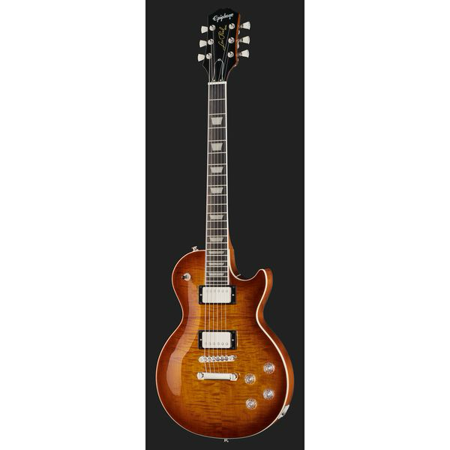
Approach 1 - Challenges & Assumptions
Image Size, Scaling, Rotation, Lighting Conditions
The retrieved “training” images seemed to have all the previous features consistent among them - out of our control, we needed to assume it to generally hold.
Background Variations:
Both “light” and “dark” background photos, with the latter only having a “dark” part in the proportion displaying the guitar.

Slide 9
Approach 1 - Steps Implemented
Considering only the Luminance Channel
More convenient and efficient to work with a single-color channel.
Histogram-Based pre-processing:
Kept only the ‘central’ part portraying the guitar.
Automatically detected the two cases of backgrounds for images based on histogram observations.
Image Blurring
Gaussian with low-sigma theoretical normal distribution to prevent over-smoothing edges.

Slide 10
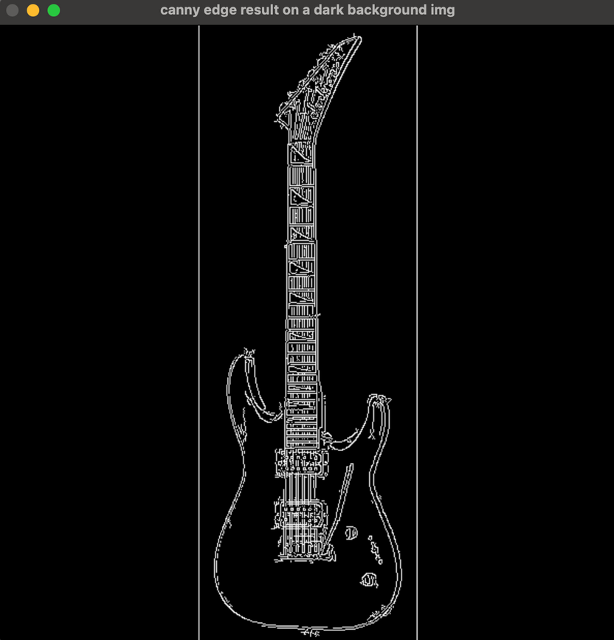
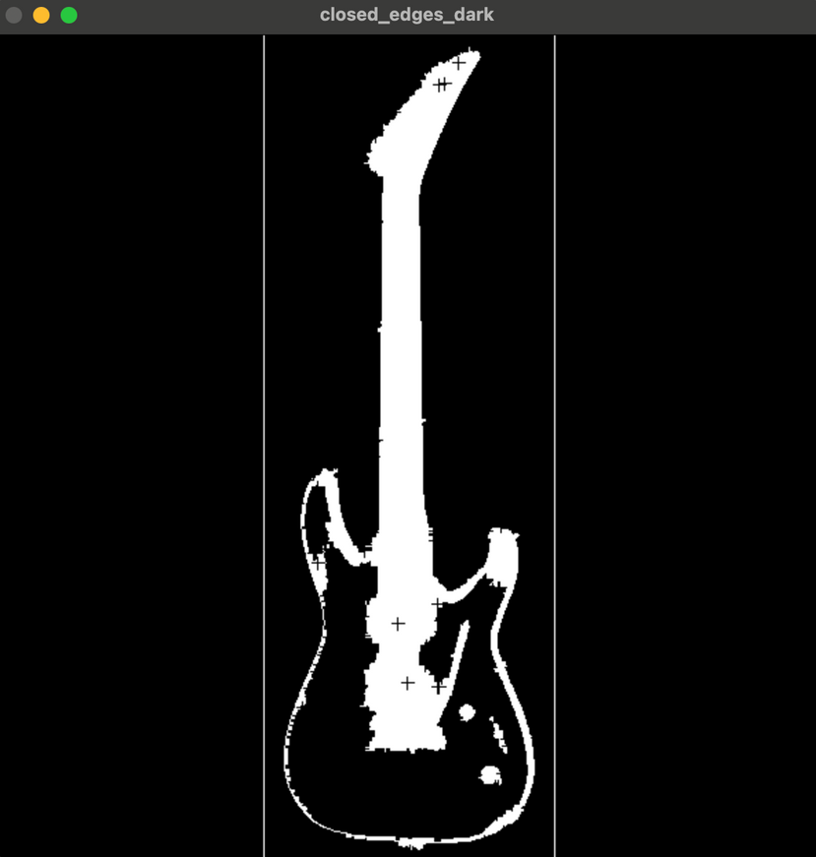
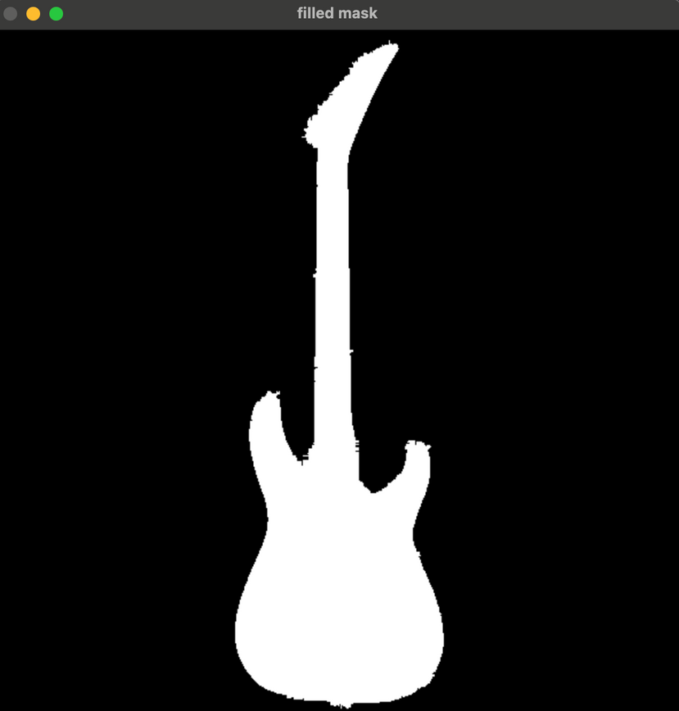
Approach 1 - Steps Implemented
Canny Edge Detection
Preserve more details.
Filling-in the detected edges - “Closing operation”
Largtest Contour Detection & Closing
CHAIN_APPROX_SIMPLE function for efficiency purposes.

Slide 11

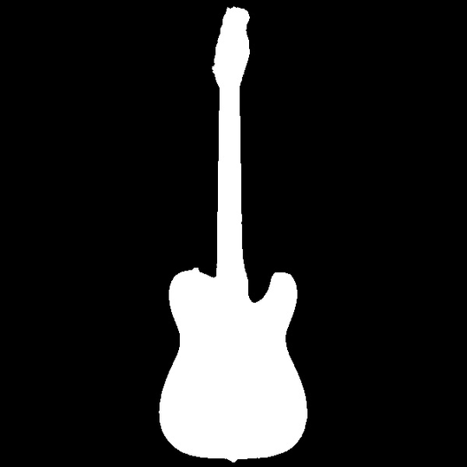

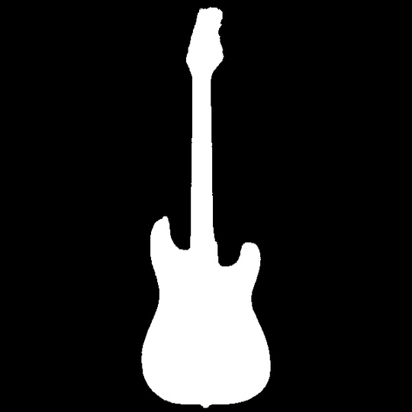
Approach 1 - Generalized Templates
Mask Generalization
Done via iterating over (~100) images of each type and averaging the results.
SG
T
LP
ST

Slide 12
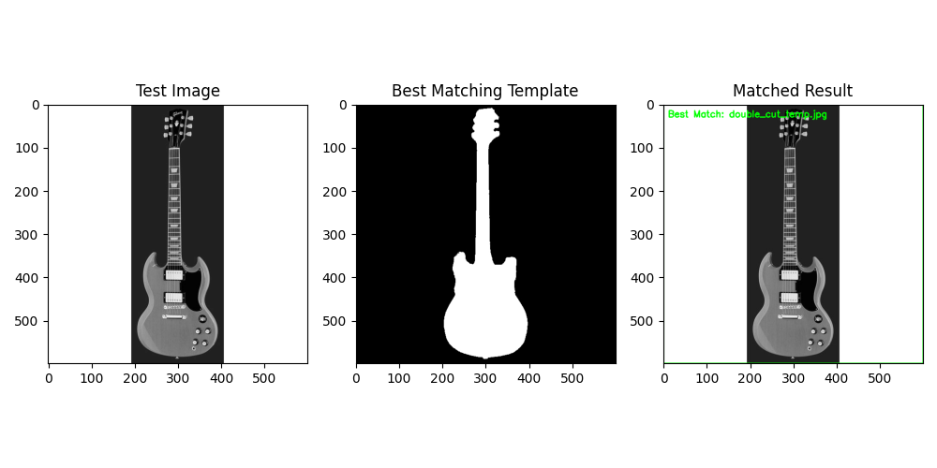
Approach 1 - Matching Example w/o Rotation & Scaling Considerations

Slide 13
Approach 1 - Matching Example w Rotation & Scaling Considerations
JESU CHRISTO

Slide 14
Approach 2 - Haar Classifier Approach
Motivation
Failure of previous naive approach to generalize on suboptimal images.
Haar approach: initially developed for face-detection applications.
However, guitars also bear characteristics that portray high variance between cases yet their position and overall outline is predictable, at least among guitars of the same type.
End Goal
Training and usage of a Haar Classifier for guitar detection on images.
Then, should this succeed, we could develop multiple classifiers to try and detect the various types, should a guitar exist on an image.

Slide 15
Approach 2 - Challenges
No Training nor Testing Datasets Available
Unable to find any training dataset containing annotated guitar objects
Visual Complexity of Guitars
Variations in guitar features probably higher than facial characteristics - potential need for very large scale training set.
Limited Computational Resources
We were only able to execute a local implementation of this approach, allowing only for a short training period of our algorithm.

Slide 16
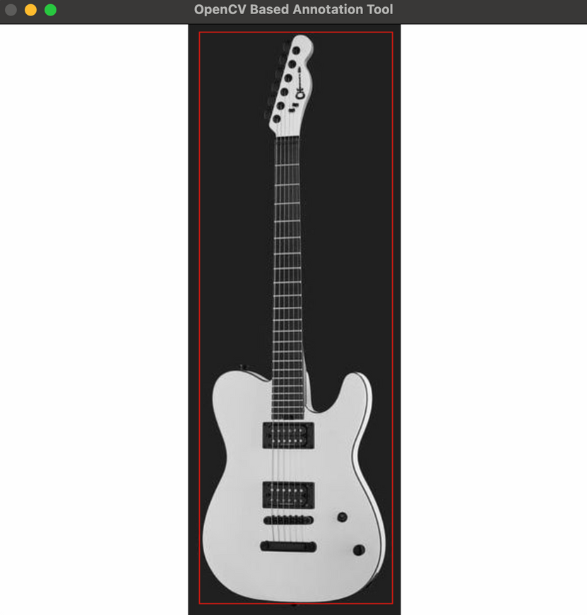
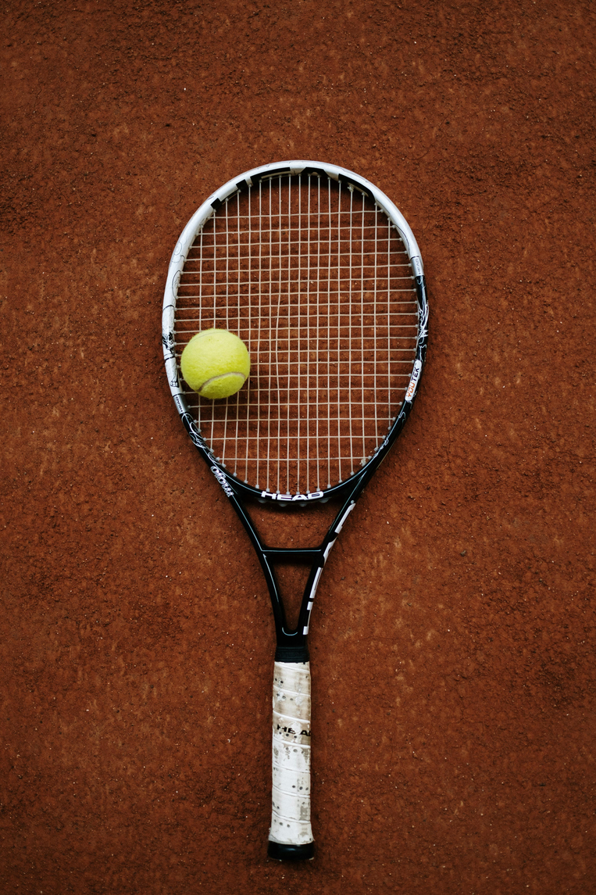
Approach 2 - Steps Implemented
Dataset Preparation
“Positive Images”/Training set: manually-annotated 250 guitar images from Thomann via the OpenCV Haar Annotation Tool.
“Negative Images”/Testing set: diverse samples of non-guitar images drawn from stock image websites (50 images total).
All images converted to resized (600x600) and converted to grayscale.
Gaussian smoothing was implemented for noise reduction.

Slide 17
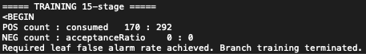
Approach 2 - Steps Implemented
Training based on the AdaBoost algorithm
Sticked to the enhanced implementation of Viola and Jones (2001).
Considered a 24x24 sliding window, allowed for 15 training stages, with a max false alarm rate of 0.3.
Performance Metrics: false negative/alarm rate - “achieved” with 15 rounds of training.
Number of unique features given windowSize [24,24] : 261600

Slide 18
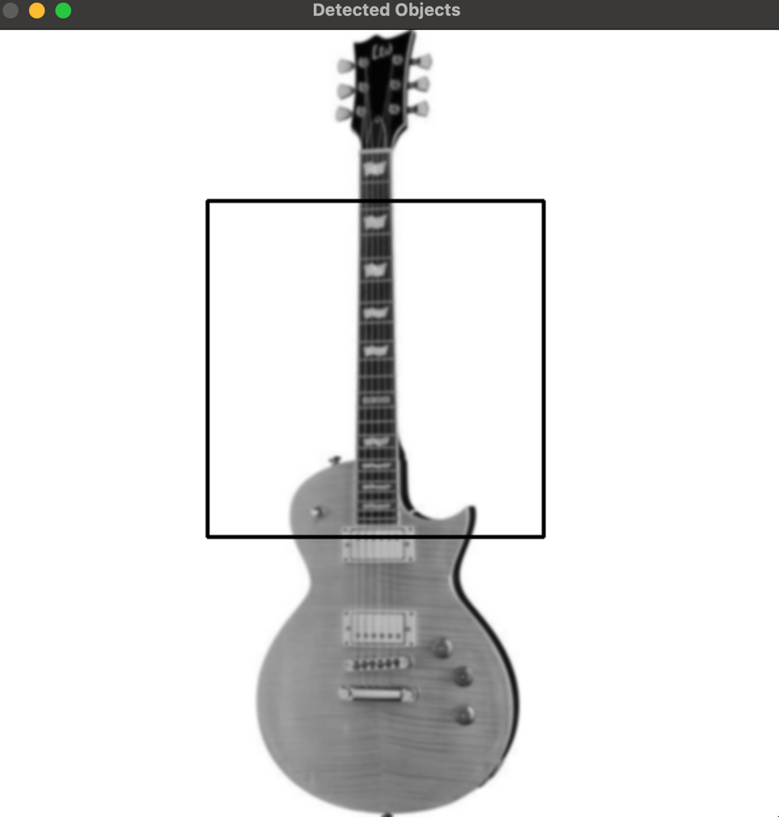
Approach 2 - Results
Very Limited Training Period - Less than 90'
The algorithm seems to have been able to only capture the ‘neck’ feature of guitars.
Due to the very limited performance, we abandoned this approach.

Slide 19
Approach 3 - Dominant Gradient Orientation-based Template Matching
Motivation
Extremely high simplicity of the first naive approach, and very bad results of the second one.
Extremely interesting paper by Daftry et al. (2021) on how NASA utilized this approach for sample-tube detection on its Perseverance rover on Mars.
Promised a color- and contrast-agnostic system, working well on texture-less objects.
Basis of this approach: the gradient orientations of the dominant (gradient magnitude-wise) color channel on the silhouette/outline of the features of interest.

Slide 20
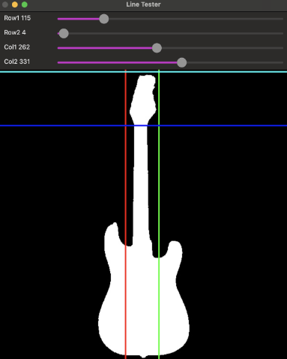
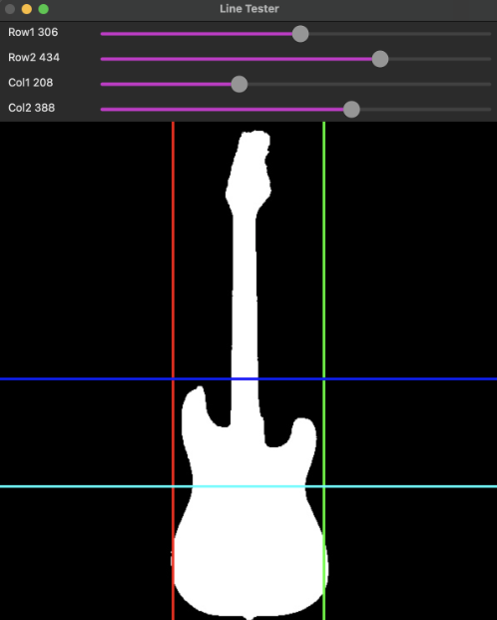
Approach 3 - Dominant Gradient Orientation-based Template Matching
Methodology for Template Creation
Out of our experience - two guitar features are the most telling of its body type; the head and the upper parts of its body.
Our previously used “positive” images served us well in creating templates for these two features based on these features.

Slide 21


Approach 3 - Dominant Gradient Orientation-based Template Matching
Methodology for Template Creation
For each type of guitar: iterated over all relevant images (after Gaussian blurring on each color channel, separately).
Every pixel of these two features was represented by the

Slide 22
Approach 3 - Dominant Gradient Orientation-based Template Matching
Methodology for Template Creation
For each type of guitar: iterated over all relevant images (after Gaussian blurring on each color channel, separately).
Every pixel of these two features was represented by the

Slide 23
Approach 3 - Dominant Gradient Orientation-based Template Matching
Methodology for Template Matching
Retained the same considerations pertaining to image pyramids and rotation augmentation.
Target images were represented as well based on their dominant gradient orientation on each pixel.
However, different thresholding values were necessary for matching the two different types of templates.

Slide 24
Approach 3 – Steps to Achieve
Methodology for Template Matching
Retained the same considerations pertaining to image pyramids and rotation augmentation.
Target images were represented as well based on their dominant gradient orientation on each pixel.
However, different thresholding values were necessary for matching the two different types of templates.

Slide 25
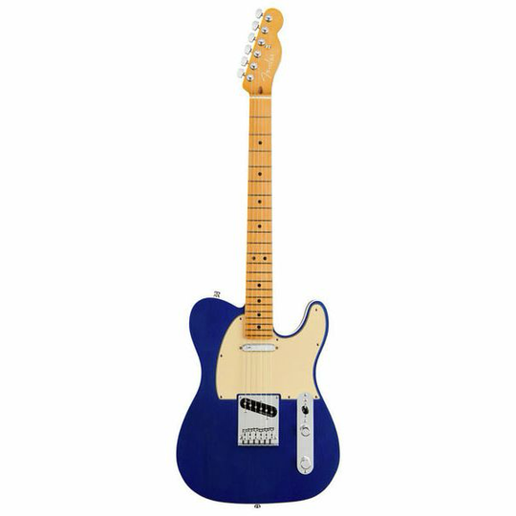
Approach 3 - Matching Example
Rotated 90 degrees

Slide 26

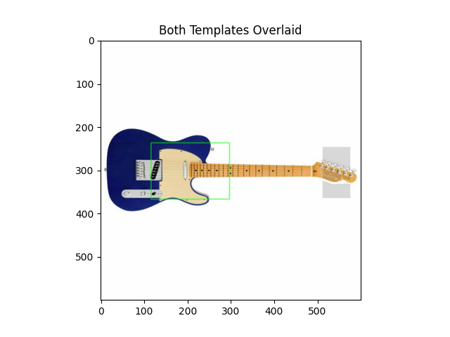
Approach 3 - Matching Example

Slide 27
Conclusions

Slide 28
Thank you for your attention!

